Slide 1

YSC2239 Lecture 6

Slide 2
Today’s class
Iteration
Chance/Probability
Reading: Chapter 8, 9

Slide 3
Important Table Methods
t.select(column, …) or t.drop(column, …)
t.take([row_num, …]) or t.exclude([row_num, …])
t.sort(column, descending=False, distinct=False)
t.where(column, are.condition(...))
t.apply(function_name, column, …)
t.group(column) or t.group(column, function_name)
t.group([column, …]) or t.group([column, …], function_name)
t.pivot(cols, rows) or t.pivot(cols, rows, vals, function_name)
t.join(column, other_table, other_table_column)

Slide 4
Comparison and Booleans

Slide 5
Comparison Operators
The result of a comparison expression is a bool value
x = 2 y = 3
x > 1 x > y y >= 3
x == y x != 2 2 < x < 5
Assignment statements
Comparison expressions

Slide 6
Aggregating Comparisons
Summing an array or list of bool values will count the True values only.
1 + 0 + 1 == 2
True + False + True == 2
sum([1 , 0 , 1 ]) == 2
sum([True, False, True]) == 2
(Demo)

Slide 7
Control Statements

Slide 8
Control Statements
These statements control the sequence of computations that are performed in a program
The keywords if and for begin control statements
The purpose of if is to define functions that choose different behavior based on their arguments
(Demo)

Slide 9
Random Selection

Slide 10
Random Selection
np.random.choice
Selects uniformly at random
with replacement
from an array,
a specified number of times
np.random.choice(some_array, sample_size)
(Demo)

Slide 11
Appending Arrays

Slide 12
A Longer Array
np.append(array_1, value)
new array with value appended to array_1
value has to be of the same type as elements of array_1
np.append(array_1, array_2)
new array with array_2 appended to array_1
array_2 elements must have the same type as array_1 elements
(Demo)

Slide 13
Iteration

Slide 14
for Statements
for is a keyword that begins a control statement
The purpose of for is to perform a computation for every element in a list or array
(Demo)

Slide 15
Optional: Advanced where

Slide 16
A Closer Look at where
t.where(array_of_bool_values)
returns a table
with only the rows of t for which
the corresponding bool is True.
(Demo)

Slide 17
Probability

Slide 18
Basics
Lowest value: 0
Chance of event that is impossible
Highest value: 1 (or 100%)
Chance of event that is certain
If an event has chance 70%, then the chance that it doesn’t happen is
100% - 70% = 30%
1 - 0.7 = 0.3

Slide 19
Equally Likely Outcomes
Assuming all outcomes are equally likely, the chance of an event A is:
number of outcomes that make A happen
P(A) = ---------------------------------------------------------------
total number of outcomes

Slide 20
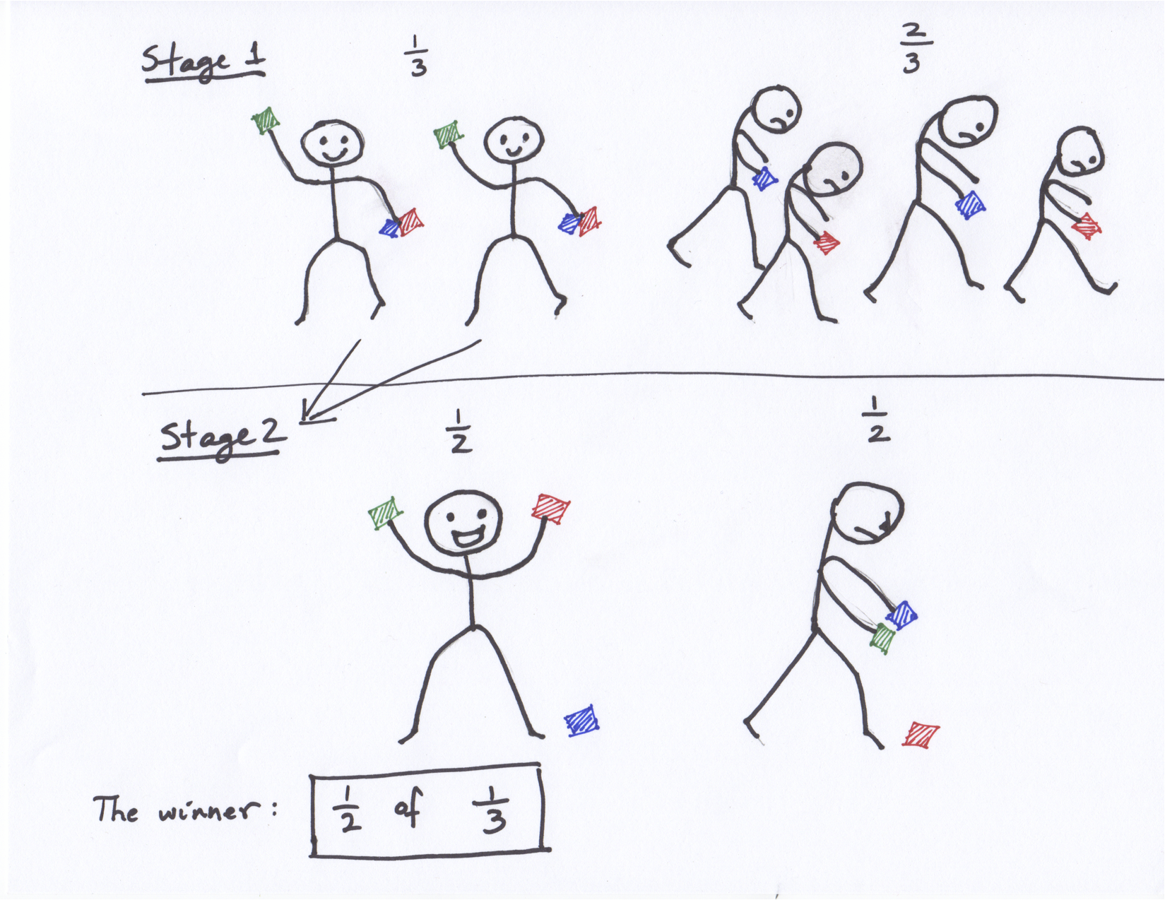
Fraction of a Fraction

Slide 21
Multiplication Rule
Chance that two events A and B both happen
= P(A happens) x P(B happens given that A has happened)
The answer is less than or equal to each of the two chances being multiplied
The more conditions you have to satisfy, the less likely you are to satisfy them all

Slide 22
Addition Rule
If event A can happen in exactly one of two ways, then
P(A) = P(first way) + P(second way)
The answer is greater than or equal to the chance of each individual way

Slide 23
Example: At Least One Head
In 3 tosses:
Any outcome except TTT
P(TTT) = (½) x (½) x (½) = ⅛
P(at least one head) = 1 - P(TTT) = ⅞ = 87.5%
In 10 tosses:
1 - (½)**10
99.9%

